Slide 1
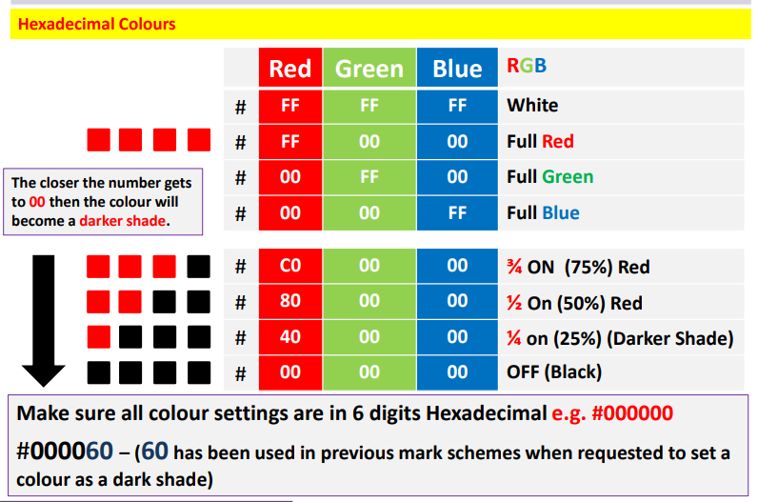
Web Authoring

Slide 2
Web Authoring
Task 8– Create the following Style Sheet:
Create a new CSS called Tiger.CSS
Style Sheet
Body | Horizontal Tile using the Tiger.JPG
H1 | Browsers Default Serif Font, Centre & 22PX
H2 | Browsers Default Sans- Serif Font, Left & 16PX
H3 | Browsers Default Sans- Serif Font, Centre & 18PX
P | Browsers Default Sans- Serif Font, Fully Justified & 11PX
LI | Arial, 14PX
OL | Decimal
UL | Square
Table | Width: 550 & Height: 400
 | Padding: Top 10 PX & Bottom 5PX
 | Margin: Right & Left 5PX
 | Internal gridline width 1.5 PX
 | External gridline width 2.5 PX
 | All Collapsed
 | All Solid Line

Slide 3
Web Authoring
Task 8– Create the following Style Sheet:
2. Apply Color Attributes
Style Sheet |  | Colour Components
Style | Attribute | Red | Green | Blue
Body |  | Yellow
H1 |  | Full Red | No Green | No Blue
H2 |  | Black
H3 |  | No Red | No Green | Full Blue
P |  | Dark Red | 50% Green | No Blue
OL |  | No Red | 50% Green | Dark Blue
UL |  | 50% Red | No Green | No Blue
Table | External Border | No Red | No Green | Full Blue
 | Internal border | No Red | Dark Green | No Blue
 | Background | Light Grey
3. Create New Tiger HTML Page and make the following tables:
Table A
Table B

Slide 4
Web Authoring
Task 8– Create the following Style Sheet:
4. Add the Following Content to Table A and apply appropriate styles:
Placed Named Anchor at top of the page.
Tiger <H1>
The tiger is the largest cat species. <P>
Tiger populations <H2> Line Space Ordered List India 2226 Malaysia 500 Bangladesh 440 Indonesia 325 China 45
 | Wikipedia Link http://en.wikipedia.org/wiki/Tiger - open in new window
 | Email Us <P> (email link to WWF@hotmail.com)

Slide 5
Web Authoring
Task 8– Create the following Style Sheet:
4. Add the Following Content to Table B and apply appropriate styles:
Tiger <H1> |  | WWF Link http://www.worldwildlife.org/species/tiger
Species <H2> Line Space Unordered List Bengal tiger Indochinese tiger Siberian tiger South China tiger Malayan tiger
 |  | Tigers once ranged widely across Asia, from Turkey in the west to the eastern coast of Russia. <P>
 |  | Contact US <P> (email link to WWF@hotmail.com with a subject line Tiger awareness)
Click here to return to the top of the page – Make Click Here the link to the anchor

